Slide 1
Data ecosystem and life cycle
CT127-3-2& Programming for Data Analysis

Slide 2
Topic Learning Outcomes
At the end of this topic, you should be able to:
1. Understand what is data eco system
2. Understand the steps involved in the data life cycle

Slide 3
Contents & Structure
What is Big Data?
What is Data EcoSystem?
Components of the Data EcoSystem
Data Life Cycle
Steps in the Data Life Cycle

Slide 4
Recap From Last Lesson
Questions to ask to trigger last week’s key learning points

Slide 5
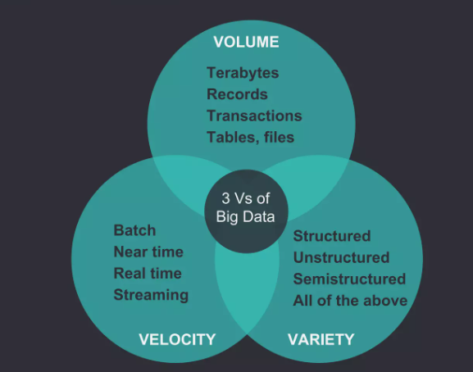
What is Big Data?
Bigdata is a data sets that are too large, complex and dynamics for any conventional data tools to capture, store, manage and analyse.

Slide 6
BIG DATA ECOSYSTEM
Data ecosystem refers to a combination of enterprise infrastructure and applications that is utilized to aggregate and analyze information.
It includes programming languages, packages, algorithms, cloud-computing services, and general infrastructure an organization uses to collect, store, analyze, and leverage data

Slide 7
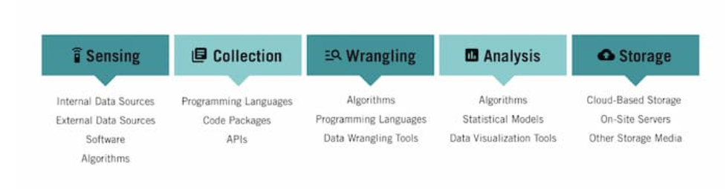
COMPONENTS OF DATA ECOSYSTEM
The concept of the data ecosystem is explored through the lens of key stages in the data project life cycle: sensing, collection, wrangling, analysis, and storage.

Slide 8
COMPONENTS OF DATA ECOSYSTEM
Sensing
Sensing refers to the process of identifying data sources for your project. It involves evaluating the quality of data so you can better understand whether it’s valuable.
This evaluation includes asking such questions as:
- Is the data accurate?
- Is the data recent and up to date?
- Is the data complete?
- Is the data valid? Can it be trusted?
Data can be sourced from
Internal data sources: Proprietary databases, spreadsheets, and other resources that originate from within your organization
External data sources: Databases, spreadsheets, websites, and other data sources that originate from outside your organization
Software: Custom software that exists for the sole purpose of data sensing
Algorithms: A set of steps or rules that automates the process of evaluating data for accuracy and completion before it’s used

Slide 9
2. Collection
Once a potential data source has been identified, data must be collected
-manual or automated processes
data scientists use programming languages to write software designed to automate the data collection process. Eg: web scraper
3. Wrangling
Data wrangling is a set of processes designed to transform raw data into a more usable format
It may involve merging multiple datasets, identifying and filling gaps in data, deleting unnecessary or incorrect data, and “cleaning” and structuring data for future analysis.
data wrangling tools –Eg: OpenRefine, DataWrangler, and CSVKit

Slide 10
4. Analysis
After raw data has been inspected and transformed into a readily usable state, it can be analyzed.
Analysis can be done using Algorithms, statistical models, visualization tools.
5. Storage
Throughout all of the data life cycle stages, data must be stored in a way that’s both secure and accessible
Cloud-based storage solutions: store data off-site and access it remotely
On-site servers: give organizations a greater sense of control over how data is stored and used
Other storage media: includes hard drives, USB devices, CD-ROMs, and floppy disks

Slide 11
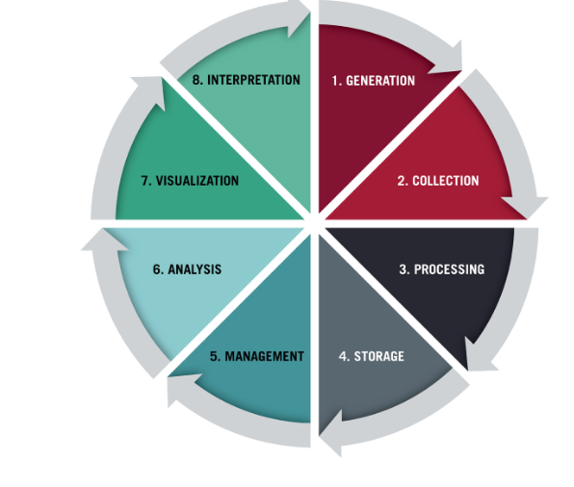
DATA LIFE CYCLE
All data projects follow the same basic life cycle from start to finish. This life cycle can be split into eight common stages, steps, or phases:

Slide 12
1. Generation
For the data life cycle to begin, data must first be generated.
Data generation occurs regardless of whether you’re aware of it, especially in our increasingly online world.
Some of this data is generated by your organization, some by your customers, and some by third parties you may or may not be aware of.
Every sale, purchase, hire, communication, interaction—everything generates data.
2. Collection
You can collect data in a variety of ways, including:
-Forms
-Surveys
-Interviews
-Direct Observation

Slide 13
3. Processing
Once data has been collected, it must be processed. Data processing can refer to various activities, including:
Data wrangling, in which a data set is cleaned and transformed from its raw form into something more accessible and usable. This is also known as data cleaning, data munging, or data remediation.
Data compression, in which data is transformed into a format that can be more efficiently stored.
Data encryption, in which data is translated into another form of code to protect it from privacy concerns.
4. Storage
After data has been collected and processed, it must be stored for future use.
This is most commonly achieved through the creation of databases or datasets.
These datasets may then be stored in the cloud, on servers, or using another form of physical storage like a hard drive, CD, cassette, or floppy disk.

Slide 14
5. Management
Data management, also called database management, involves organizing, storing, and retrieving data as necessary over the life of a data project.
It includes encryption, track who has accessed data and what changes they may have made.
6. Analysis
Data analysis refers to processes that attempt to retrieve meaningful insights from raw data.
Commonly used methods for analysis include statistical modeling, algorithms, artificial intelligence, data mining, and machine learning.

Slide 15
7. Visualization
Data visualization refers to the process of creating graphical representations of your information, typically through the use of one or more visualization tools.
Visualizing data makes it easier to quickly communicate the analysis
8. Interpretation
The interpretation phase of the data life cycle provides the opportunity to make sense of your analysis and visualization.
Beyond simply presenting the data, this is when you investigate it through the lens of your expertise and understanding

Slide 16
Review Questions
-What is Big Data?
-What is Data EcoSsytems?
-What are the components of Data Ecosystems?
-What is Data Life Cycle?
-What are the steps involved in the Data Life Cycle?

Slide 17
Summary / Recap of Main Points
Data Ecosystems and its Components
Data Lifecycles and steps/phases involved in Data Lifecycle

Slide 18
What To Expect Next Week
In Class
Preparation for Class
Overview of Data Analytics

